Slide 1
Creating the Auth Module

Slide 2
Creating the Auth Module
The process for creating the feature module follows the same pattern you have seen in earlier lessons.
The key difference is that it is important that no other part of the application has dependencies on the module or the classes it contains, which would undermine the dynamic loading of the module and cause the JavaScript module to load the administration code, even if it is not used.
The starting point for the administration features will be authentication, which will ensure that only authorized users are able to administer the application.

Slide 3
Creating the Auth Module
Let’s create a file called auth.component.ts in the src/app/admin folder and add the following code:
import { Component } from "@angular/core";
import { NgForm } from "@angular/forms";
import { Router } from "@angular/router";
@Component({
templateUrl: "auth.component.html"
})
export class AuthComponent {
public username: string;
public password: string;
public errorMessage: string;
constructor(private router: Router) {}
authenticate(form: NgForm) {
if (form.valid) {
// perform authentication
this.router.navigateByUrl("/admin/main");
} else {
this.errorMessage = "Form Data Invalid";
}
}
}

Slide 4
Creating the Auth Module (continued)
To provide the component with a template, let’s create a file called auth.component.html in the src/app/admin folder and add the following code:
<div class="bg-info p-2 text-center text-white">
<h3>SportsStore Admin</h3>
</div>
<div class="bg-danger mt-2 p-2 text-center text-white"
*ngIf="errorMessage != null">
{{errorMessage}}
</div>
<div class="p-2">
<form novalidate #form="ngForm" (ngSubmit)="authenticate(form)">
<div class="form-group">
<label>Name</label>
<input class="form-control" name="username"
[(ngModel)]="username" required />
</div>
<div class="form-group">
<label>Password</label>
<input class="form-control" type="password" name="password"
[(ngModel)]="password" required />
</div>
<div class="text-center">
<button class="btn btn-secondary m-1" routerLink="/">Go back</button>
<button class="btn btn-primary m-1" type="submit">Log In</button>
</div>
</form>
</div>

Slide 5
Creating the Auth Module (continued)
To create a placeholder for the administration features, we will add file called admin.component.ts in the src/app/admin folder and define the component shown:
import { Component } from "@angular/core";
@Component({
templateUrl: "admin.component.html"
})
export class AdminComponent {}

Slide 6
Creating the Auth Module (continued)
The component doesn’t contain any functionality at the moment. To provide a template for the component, we will add a file called admin.component.html to the src/app/admin folder with the placeholder content:
<div class="bg-info p-2 text-white">
<h3>Placeholder for Admin Features</h3>
</div>

Slide 7
Creating the Auth Module (continued)
To define the feature module, we add a file called admin.module.ts in the src/app/admin folder and add the following code:
import { NgModule } from "@angular/core";
import { CommonModule } from "@angular/common";
import { FormsModule } from "@angular/forms";
import { RouterModule } from "@angular/router";
import { AuthComponent } from "./auth.component";
import { AdminComponent } from "./admin.component";
let routing = RouterModule.forChild([
{ path: "auth", component: AuthComponent },
{ path: "main", component: AdminComponent },
{ path: "**", redirectTo: "auth" }
]);
@NgModule({
imports: [CommonModule, FormsModule, routing],
declarations: [AuthComponent, AdminComponent]
})
export class AdminModule { }

Slide 8
Configuring the URL Routing System
Dynamically loaded modules are managed through the routing configuration, which triggers the loading process when the application navigates to a specific URL.
The following code listing in the app.module.ts file in the src/app folder extends the routing configuration of the application so that the /admin URL will load the administration feature module:
...
{path: 'checkout', component: CheckoutComponent, canActivate: [StoreFirstGuard]},
{path: 'admin’,
loadChildren: () => import('./admin/admin.module’)
.then(m => m.AdminModule), canActivate: [StoreFirstGuard]},
{path: '**', redirectTo: ‘/store', pathMatch: 'full’}
...

Slide 9
Configuring the URL Routing System (continued)
The new route tells Angular that when the application navigates to the /admin URL, it should load a feature module defined by a class called AdminModule from the admin/admin.module.ts file, whose path is specified relative to the app.module.ts file.
When Angular processes the admin module, it will incorporate the routing information it contains into the overall set of routes and complete the navigation.

Slide 10
Navigating to the Administration URL
The final preparatory step is to provide the user with the ability to navigate to the /admin URL so that the administration feature module will be loaded, and its component displayed to the user.
The following code listing in the store.component.html file in the src/app/store folder adds a button to the store component’s template that will perform the navigation:
...
<button *ngFor="let cat of categories"
class="btn btn-outline-primary btn-block"
[class.active]="cat == selectedCategory"
(click)="changeCategory(cat)">
{{cat}}
</button>
<button class="btn btn-block btn-danger mt-5“ routerLink="/admin">
Admin
</button>
</div>
...

Slide 11
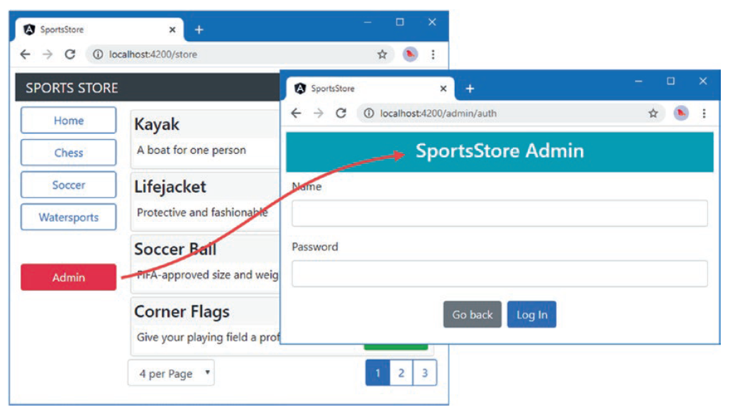
Navigating to the Administration URL (continued)
The files for the administration module will not be loaded until you click the Admin button, at which point Angular will request the files and display the login page:

Slide 12
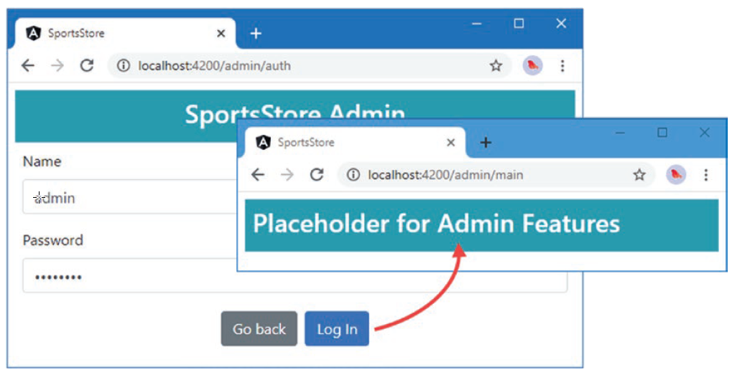
Navigating to the Administration URL (continued)
Enter any name and password into the form fields and click the Log In button to see the placeholder content, as shown in the following figure. If you leave either of the form fields empty, a warning message will be displayed.

